Slide 1
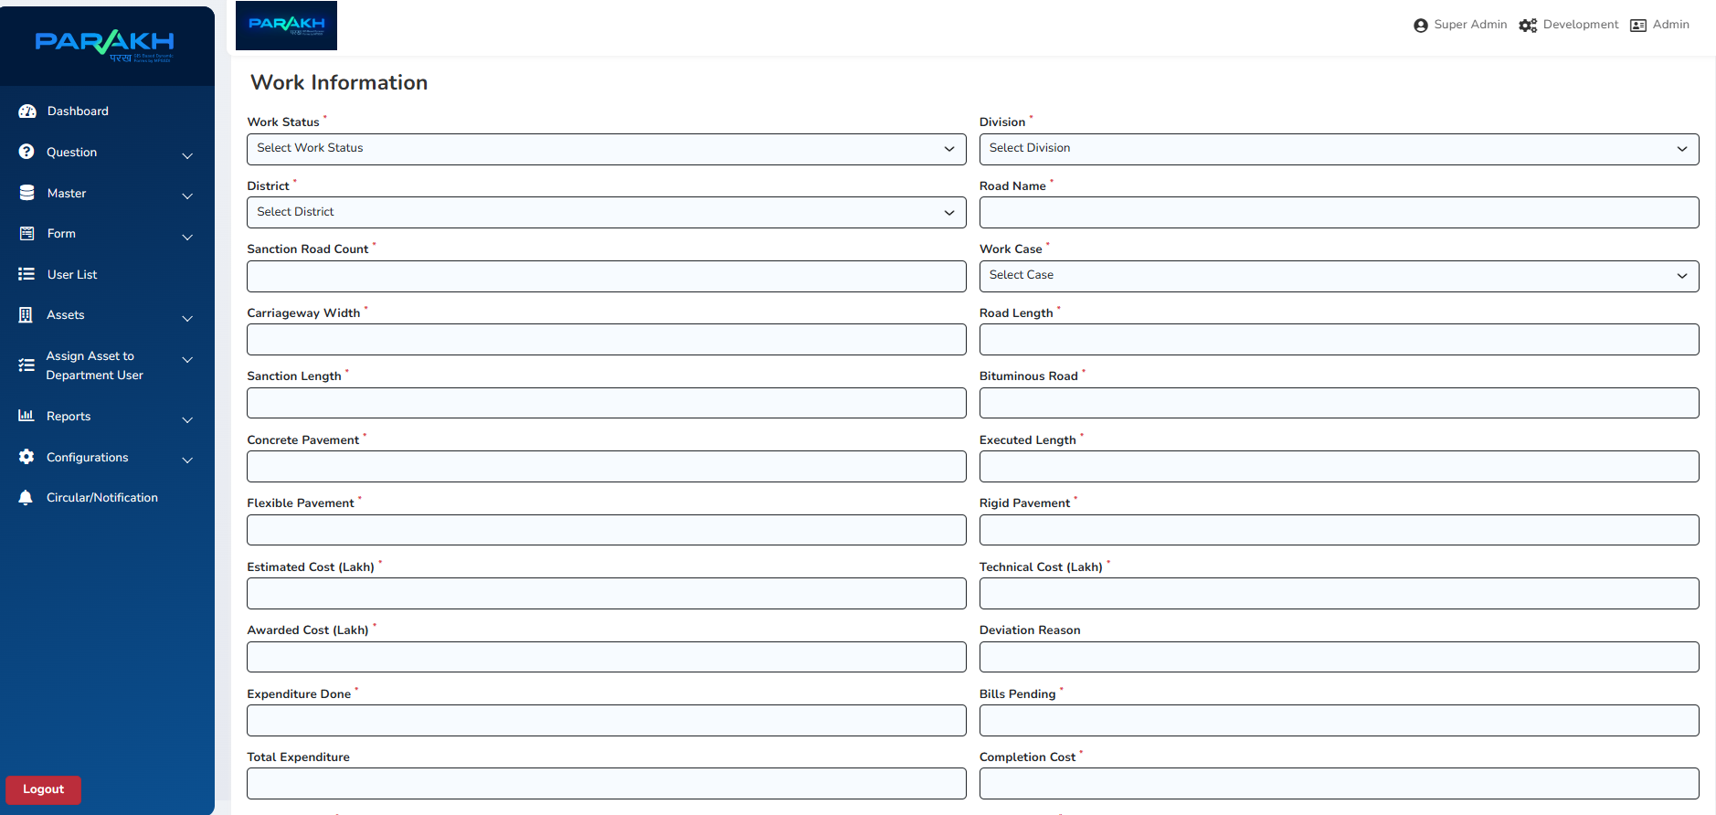
UADD Asset/Road Inspection
Part 1: Road Work Details

Slide 2
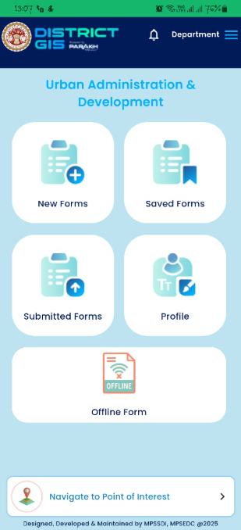
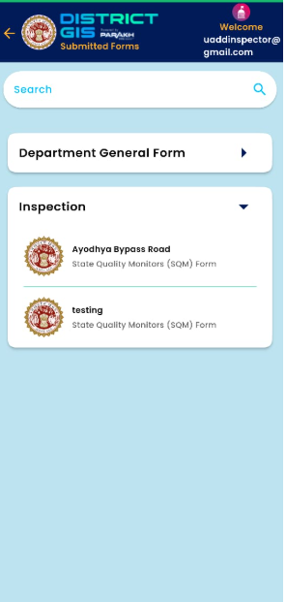
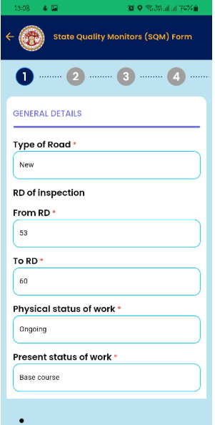
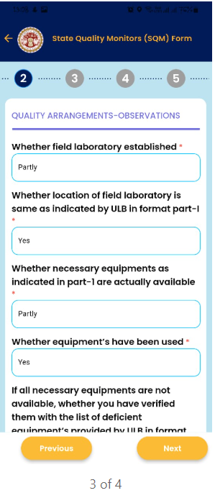
Part 2: Field Inspection of Road Work Progress (Mobile View)
Road Inspection will be conducted by the Field Officer/AE

Slide 3
Current Status & Progress
Part 1: The Road Detail/Asset form is created in Web Portal and given to the department for verification in UAT environment. Finalization is due from Department’s side.
Part 2: Inspection of the Road by the AE is created and launched in the UAT environment. Handed over to the department for verification.
Department to share the workflow of the inspections to be conducted

